Slide 1


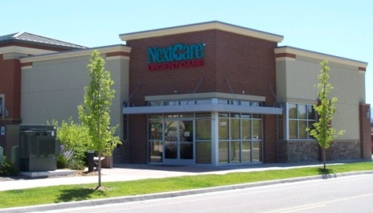

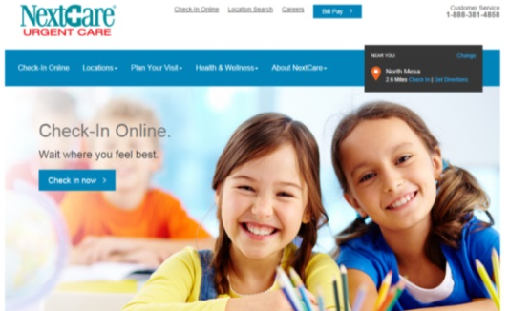
NextGen Client Innovation Contest
2020 – 11 – 12
Kevin Foster
Notes:
Hello UGM 2020 to everyone watching this “live”, for those watching the recording good morning, good afternoon, or good evening.
I’m Kevin Foster with NextCare Holdings here to talk about our client innovation submission.

Slide 2
WHO WE ARE
Urgent Care Specialty
148 Clinics across 15 Practices
700+ Full/Part Time Providers
Operate in 11 States
4 Separate Time Zones (AZ, MST, CST, EST)
Notes:
So, just a little bit about who we are:
A special welcome to our new Michigan Urgent Care friends

Slide 3
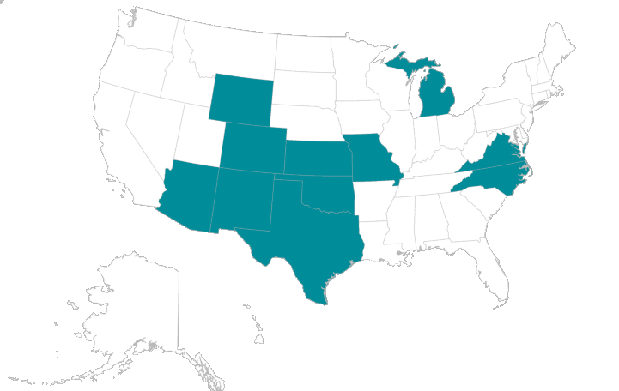
WHERE WE ARE
Notes:
Each of our 15 practices operate in a single state. This point will be important and come back up as we get into our solution. This map simply shows that we will be working with several different states, each with their own unique challenges.

Slide 4

OUR PROBLEM
Reporting COVID-19 Testing
Who Must Report?
COVID-19 testing sites are defined as
laboratories that perform clinical diagnostic or screening testing under CLIA,
non-laboratory COVID-19 diagnostic or screening testing locations, and
other facilities or locations offering COVID-19 point-of-care diagnostic or screening tests, or in-home diagnostic or screening tests.
https://www.cdc.gov/coronavirus/2019-ncov/lab/reporting-lab-data.html#who-must-report
Notes:
WHAT WE SOLVED
Our facilities have been performing onsite testing since early April. As part of the pandemic management, testing facilities are required to report findings to the state and local health department.
Each state is different: some offering a web form to fill out while others require manual data entry on a spreadsheet.
But this does not (and should not) need to be a such a laborious process.

Slide 5
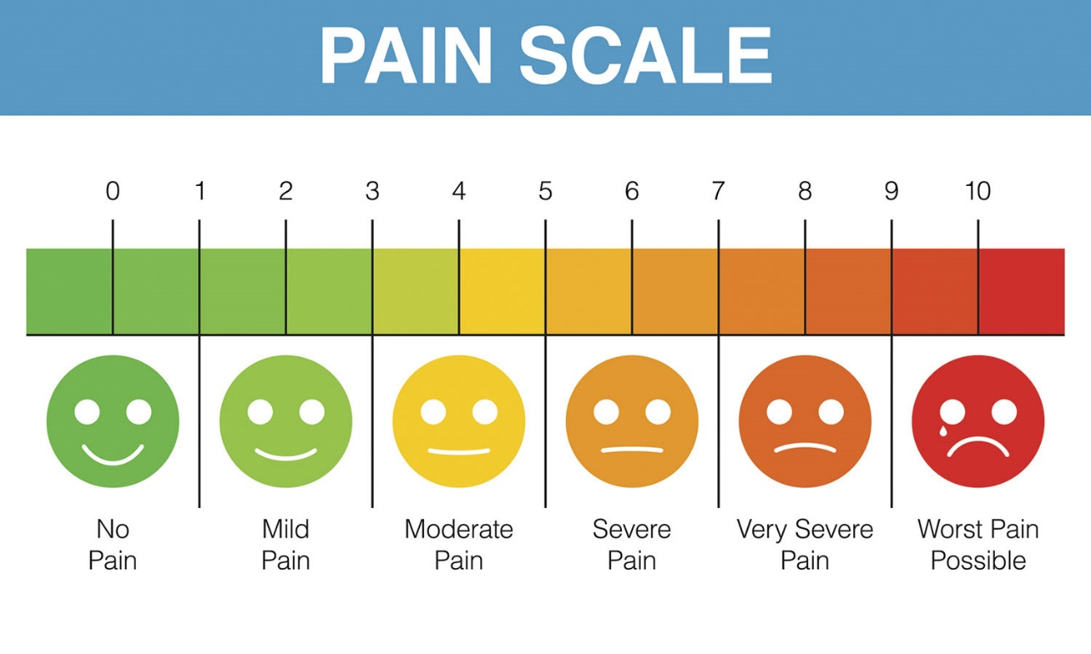
OUR PROBLEM
Reporting Pain Points
Workload
Timeliness
Accuracy
Omissions
Notes:
WHY WE SOLVED IT
It’s been tough to get a good read of the staffs’ faces to compare to the pain scale due to PPE, but we’re pretty sure it’s towards the top end.
The big wins with the automation?
Obviously the automation of the workload is important to free staff up to continue patient care. Additional benefits also include:
Timeliness of reporting -> Provides real-time reporting capabilities
Ensures accuracy. The information in the chart exactly matches what is reported to the DHS
Avoids omission of negatives.

Slide 6
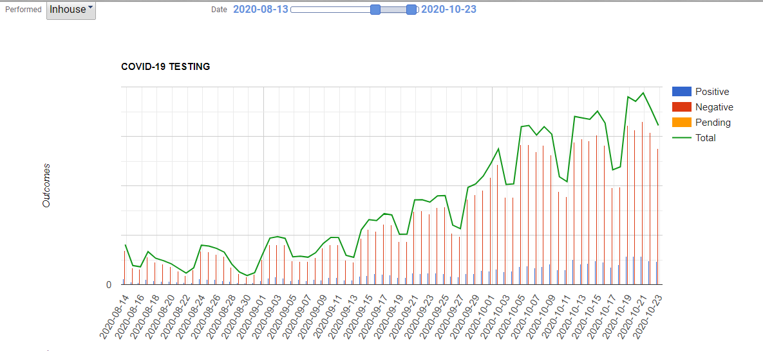
OUR PROBLEM
Clinical Staff Must Focus On Patient Care
Testing Volume Has Quadrupled
Notes:
The need for testing continues to grow.
…a couple of reasons for the rise: more testing machines in more states. More access to testing supplies. But some portion of this is a result of implementing our solution.

Slide 7
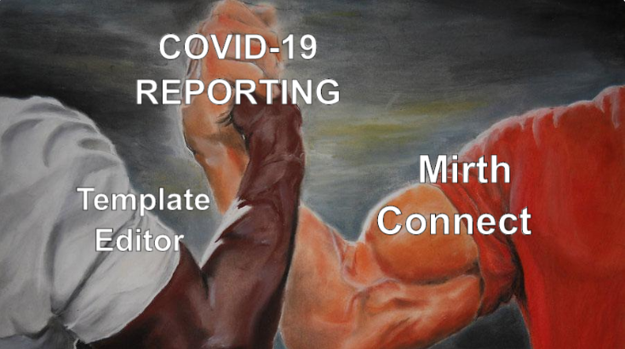
OUR SOLUTION
A Two-Fold Solution
Completely Within The NextGen Ecosystem
Template Editor & Mirth Connect
Notes:
HOW WE SOLVED IT
For states that offered an electronic lab reporting (ELR) option, we automated the reporting process!
The Abbott ID Now device does offer an HL7 interface option, but it was not able to meet any of the state specifications.

Slide 8
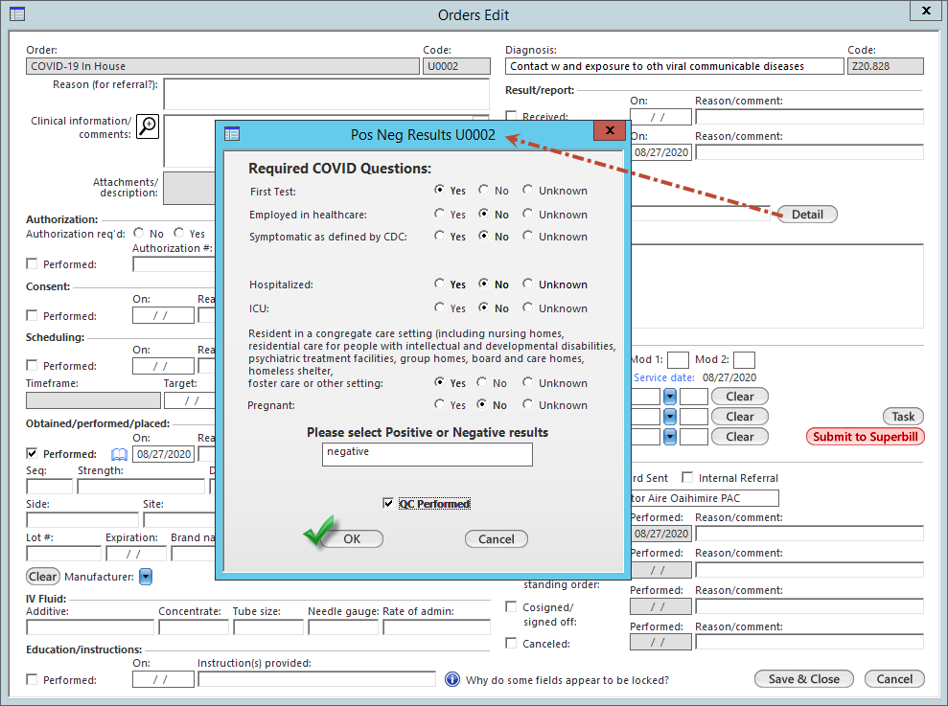
EHR WORKFLOW
Office Services Test Menu
COVID-19 HHS AoE Questions
https://www.hhs.gov/sites/default/files/covid-19-laboratory-data-reporting-guidance.pdf
Notes:
WHAT MAKES THIS A CUSTOM SOLUTION?
All of our inhouse testing is ordered *AND RESULTED* directly from the Office Diagnostics / Office Services template, not in the orders module. Now, we could process this, using the Orders Module Processing template, and send the order out, on an interface by interface basis, but this wouldn’t solve the problem of sending the test outcome to the health department. We need the order AND the result.
Another part of the workflow came part way into the year when the Health and Human Services department added some additional data elements in early June that must be reported by laboratories along with the COVID-19 test results.
Normally we would see AOE questions in the orders module, or as part of the order module processing. Because we are documenting inhouse testing exclusively within the KBM/ACE templates, we included these questions on the results detail popup for our COVID-19 orders.

Slide 9

BEHIND THE SCENES
Convert the EHR data
State preference for either HL7 or CSV
Notes:
While the clinical staff are working hard providing excellent patient care, Mirth Connect is doing the heavy lifting of transcribing the EHR’s documentation into a format deemed appropriate for the state health department’s needs. Here we can see that a couple of our interfaced states accept HL7 (OK, CO, VA), while others (AZ, NC, TX) accept a daily CSV flat file upload.

Slide 10

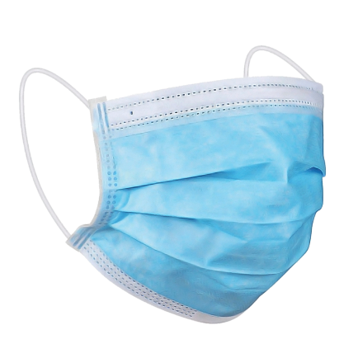
DEMO

Slide 11


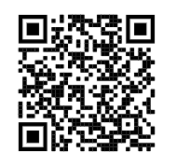
QUESTIONS?
Kevin Foster
kevinfoster@nextcare.com
linkedin.com/in/kevinandrewfoster/
Download the files here:
https://github.com/kevinfosterNG/ugm/tree/master/2020
Thank You!
Notes:
We’ll be answering questions in the session. But this slide also includes some contact information for me, as well as a github repo with a sampling of the template and Mirth channels.
Thank you everyone for your time. Thank you to all the front line staff for all your hard work.
Stay safe everyone. Bye!

